Slide 1


PROJECT PHASE ZERO PRESENTATION TOPIC:Automated Embedded System for Sustainable Rainwater Harvesting and Solar Power Management
K.S.INSTITUTE OF TECHNOLOGY
Department of Electronics and Communication Engineering
Accredited by NAAC and NBA
#14,Raghuvanahalli,Kanakapura Road,Bengaluru-560109
TEAM MEMBERS
PRAJWAL - 1KS22EC074
MEGHARAJ - 1KS22EC064
SHASHANK - 1KS22EC089
TAHA - 1KS22EC065

Slide 2
INTRODUCTION
Water scarcity and energy shortage are major problems faced by both the urban and rural areas. Earth is made up of 75% water, out of which only 2.5% is freshwater and 1% is accessible. Climate change, irregular rainfall and lack of water storage facilities have resulted in wasted rainwater and growing demand for renewable energy.
To address these issues, we introduce Automated Embedded System for Sustainable Rainwater Harvesting and Solar Power Management– a dual purpose system which,
Collects and purifies rainwater for domestic uses.
Captures solar energy to generate electricity.

Slide 3
PROBLEM IDENTIFICATION
Due to population and urbanization there is critical shortage of accessible freshwater and reliable power sources. Despite receiving ample rainfall, a significant portion of water is wasted due to poor storage and harvesting systems.
Urban areas face challenges such as drainage clogging from runoff, road flooding, and declining groundwater levels.
To address these challenges, this project introduces the " Solar methods", this device captures and purifies rainwater while also harnessing solar energy for power generation.

Slide 4
OBJECTIVES
The project focuses on developing a sustainable solution for rainwater harvesting and solar energy harnessing in agricultural land using an innovative design that includes:
Harvesting rainwater to meet increasing water demands, reducing runoff, preventing flooding, and raising the water table.
Utilizing solar energy to enhance sustainability, improve energy access, and reduce reliance on conventional power sources.
Creating an eco-friendly infrastructure to support activities like water purification, energy generation, and mobile charging.

Slide 5
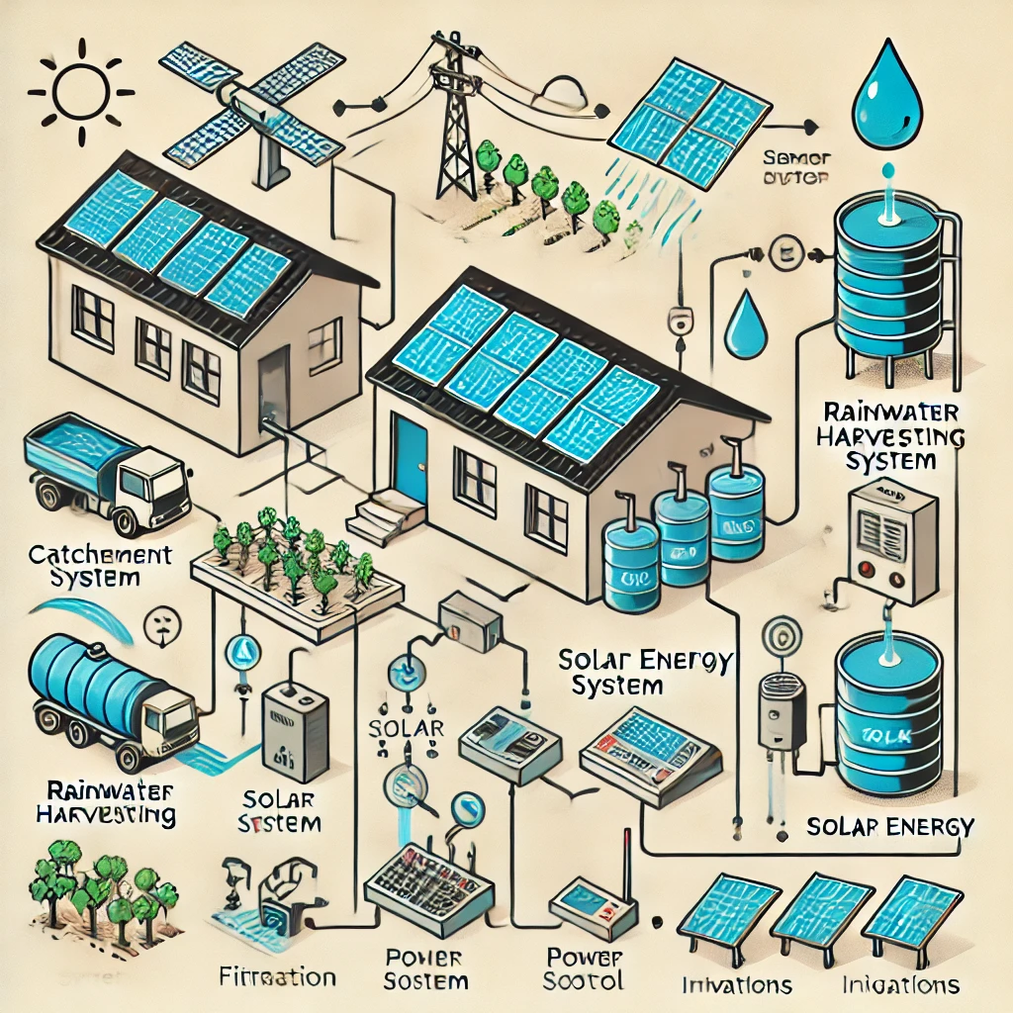
APPLICATIONS
Rainwater Harvesting – Collects & purifies rainwater for drinking, irrigation, and sanitation.
Solar Energy Generation – Provides power for lighting, charging, and other uses.
Urban & Rural Use – Helps reduce flooding, supports public spaces, farms, and campuses.
Sustainable Agriculture – Supplies water for crops and solar power for irrigation.
Disaster & Remote Areas – Provides clean water & energy where infrastructure is lacking.
Smart Cities & Green Energy – Supports eco-friendly urban planning and sustainability goals.

Slide 6
CONCLUSION
By using this type of rain water harvesting it provides clean water, energy and also provide environment shading at a lower cost.
Each reverse umbrella take about 1 square feet of area and one unit of reverse umbrella can collect 40,000 litters of water during rainy season.
It also captures energy with maximum power of 400–800 Wh/day and it all depends upon climate conditions and efficiency of solar panels.
We can install multiple units of reverse umbrella in agricultural land area, this project helps to save every drop of rainwater and runoff. And is an eco friendly and energy efficient solution.

Slide 7
THANK YOU

